Slide 1
Death Event Prediction
On Heart Failure Clinical Records
With Supervised Machine Learning Technique
Introduction to Supervised Machine Learning
Final Project
Sandy Hsu
February, 2024

Slide 2
Project Topic
Heart Failure is a very common event causes by the cardiovascular disease (CVDs). CVDs is one of the most important topic in medicine, which estimated to take away 17.9 million lives each year worldwide. Thus, building a high precision and accuracy machine learning model for early detection is in need. This real-world clinical dataset included high cardiovascular risk factors such as hypertension, diabetes, hyperlipidaemia, and others, which would give great insights and possible application for early detection and future prevention as a goal.
This dataset was based on the records of heart failure patients who had death event as an outcome during the follow up period between 4 to 284 days. I uilterized six different supervised machine learning models, such as random forest, Gradient Boosting Classifier, Ada Boosting, Support Vector Machine, KNN, and Cat boosting, designed for classification task to identify the death event from the records. The best performing model is Random Forest classification with accuracy of 0.875.

Slide 3
Dataset Source & Cleaning
A public dataset from UC Irvine Machine Learning Repository: click for the Dataset
First published with Journal:
Davide Chicco, Giuseppe Jurman: "Machine learning can predict survival of patients with heart failure from serum creatinine and ejection fraction alone". BMC Medical Informatics and Decision Making 20, 16 (2020).
Dataset were collected from the medical records of 299 heart failure patients at the Faisalabad Institute of Cardiology and at the Allied Hospital in Faisalabad (Punjab, Pakistan), during April to December 2015
Data set came in tabulated format with 299 records, 12 features, and 1 target column.
The data type of each features is included in the next slide.
The dataset is clean; however, few tasks still perform to ensure the cleanliness of the dataset, such as data type consistency, duplicate, outlier analysis, etc. Most of these are concluded clean from the result of code or pair plot.

Slide 4
Feature Name | Type | Description
age | Integer | age of the patient
anaemia | Binary | decrease of red blood cells or hemoglobin
creatinine_phosphokinase | Integer | level of the CPK enzyme in the blood
diabetes | Binary | if the patient has diabetes
ejection_fraction | Integer | percentage of blood leaving the heart at each contraction
high_blood_pressure | Binary | if the patient has hypertension
platelets | Continuous | platelets in the blood
serum_creatinine | Continuous | level of serum creatinine in the blood
serum_sodium | Integer | level of serum sodium in the blood
sex | Binary | woman or man
smoking | Binary | if the patient smokes or not
time | Integer | follow-up period
Death_event (Target) | Binary | if the patient died during the follow-up period
Data Type of the Features in the Dataset

Slide 5
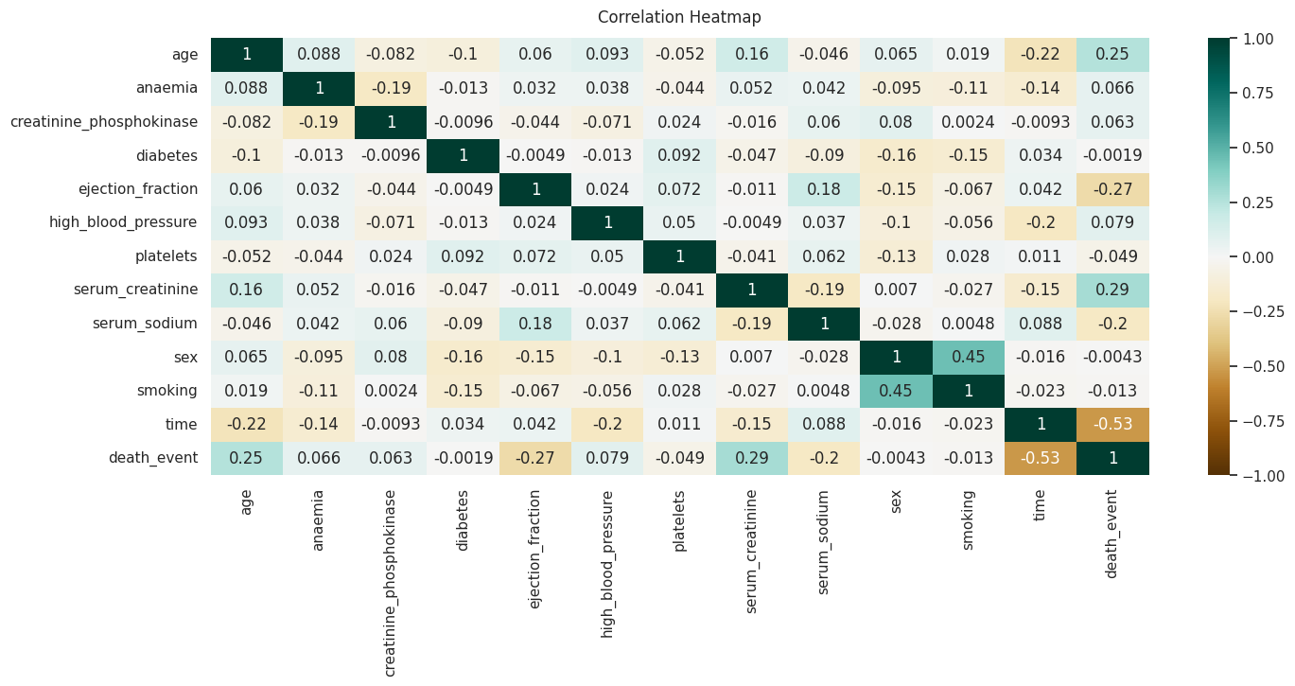
Exploratory Data Analysis:
Correlation
Heatmap
The heatmap shows the correlation values between a pair of features. As the color shown in the heapmap, serum creatinine, ejection fraction, age, serum sodium, and follow up time are the most important features that has relatively higher correlation value compare again the death event.

Slide 6
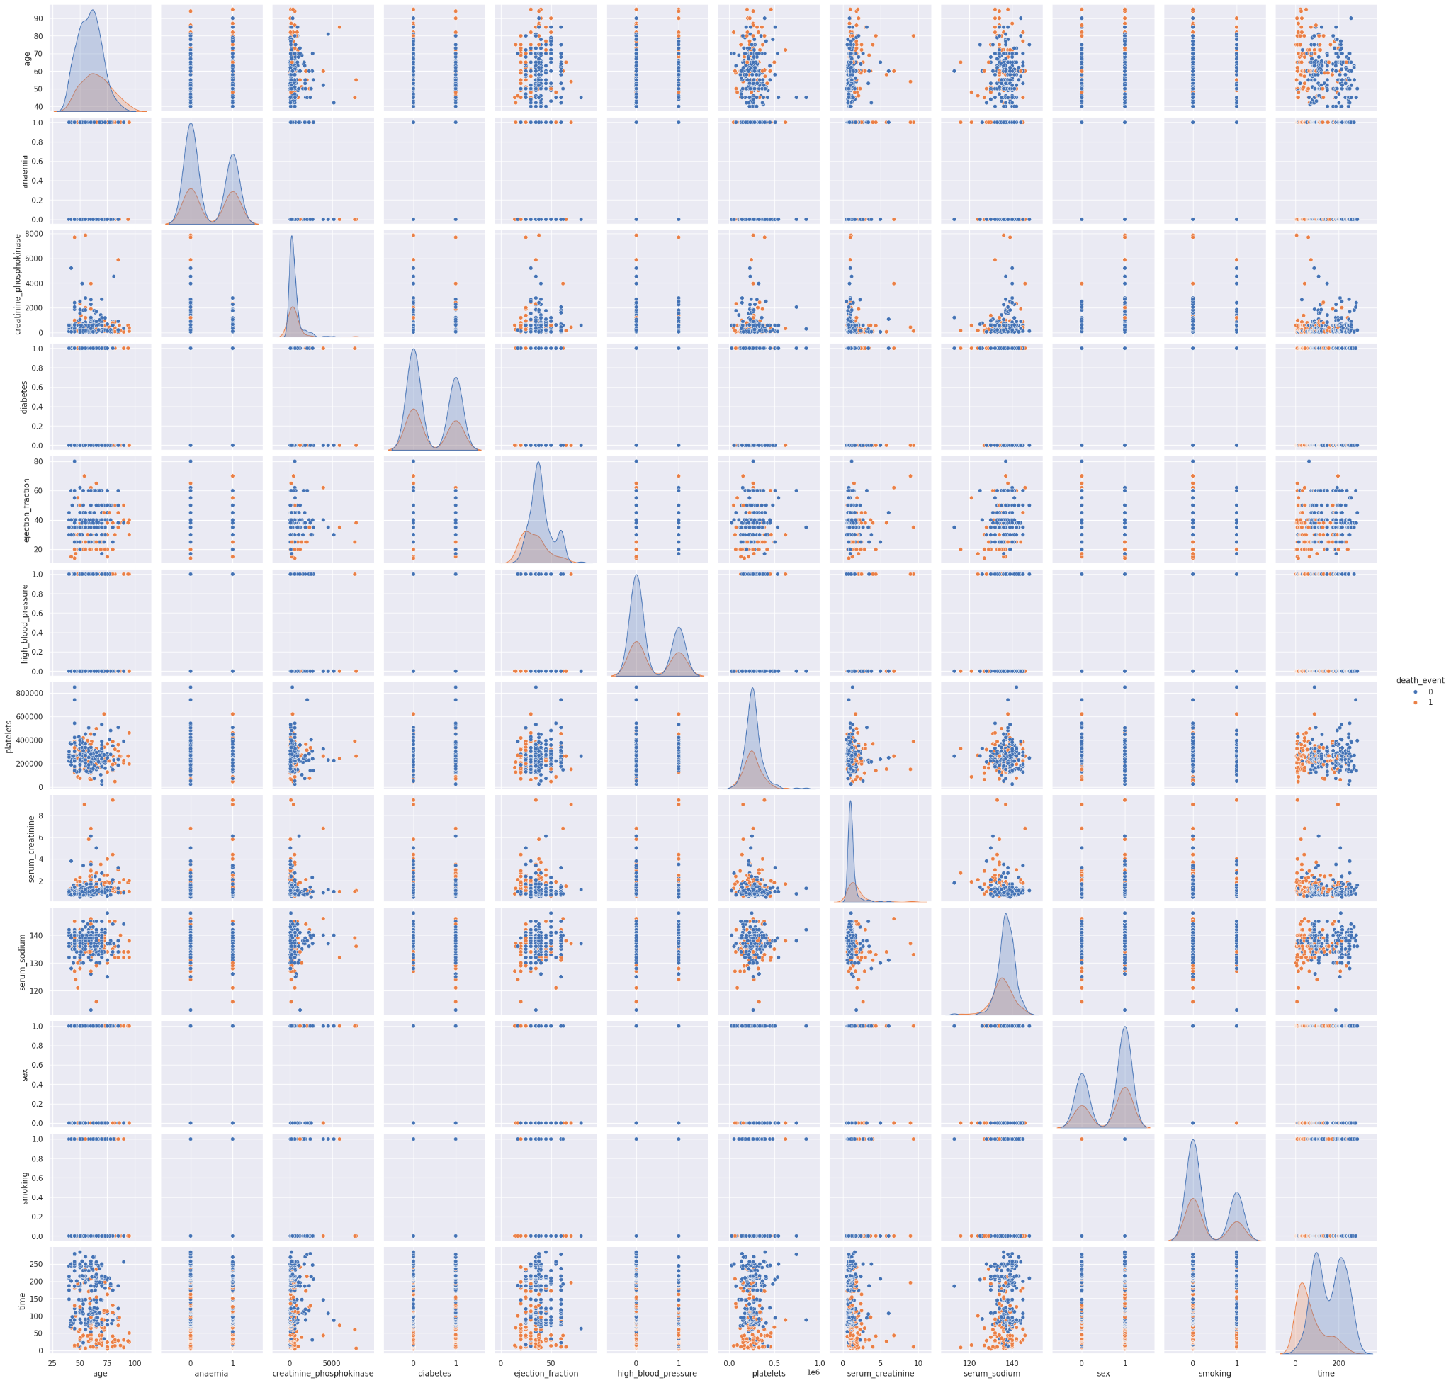
Pair plot gives insights to how the data behave according to a specific pairs of features. The color coded data shows the location of different binary value of the data.
Consider that there is no easy visual classification between the two data value in any of the scatter plot, SVM and KNN models probably would not do well in this dataset. Both SVM and KNN models were based on separating the data into groups.
Apologize the unclear graph.
Exploratory Data Analysis: Pair Plot

Slide 7
Models : Collinearity Analysis
Collinearity is an very important concept in feature selection. It has large impact on Linear Regression models; however, it also increase the difficulty to classify tree based machine learning model. Collinearity is when two features are highly correlated to each other. When a pair of features are highly correlated, the decision of such feature at the leaf level would be unstable and cost overall standard error associated with the two features to increase.
In the correlation heatmap values and the pair plot, there is no evidence of highly correlated pair of features in this dataset. Thus, it confirmed that there is no such effect with the choice of the model here.

Slide 8
Models : Data Imbalance Issue
Unfortunately, this dataset has data imbalance issue.
The binary death event has survive to death ratio of 203 to 96
Address the imbalance issue with two attempted techniques:
Standard Scale - Normalize all features
Used build in Python library: from sklearn.preprocessing import StandardScaler
Not useful - both top models, Random Forest & Gradient Boosting, dropped accuracy score or no effect
Downsampling - Reduce the numbers of the survived patient records to match ones with death event
Used build in Python library: from sklearn.utils import resample
Improved Random Forest models, but not helping Gradient Boosting.
Clear winner strategy for model turning
Easy for interpretation with domain knowledge
Please reference all the results from next pages.

Slide 9
Models & Result : Multi-ML models
Random Forest, Gradient Boosting Classifier, Ada Boosting, Support Vector Machine, KNN, and Cat Boosting
Model | Accuracy | Precision | Recall | F1 | Standard Scale | # Sample Trained | # Features Included
Random Forest | 0.85 | 0.87 | 0.81 | 0.83 | no | 299 | 12
 | 0.84 | 0.86 | 0.79 | 0.81 | yes | 299 | 12
 | 0.88 | 0.87 | 0.87 | 0.87 | no | 192 | 12
 | 0.88 | 0.87 | 0.87 | 0.87 | yes | 192 | 12
 | 0.85 | 0.85 | 0.85 | 0.85 | yes | 192 | 5
Gradient Boosting Classification | 0.87 | 0.88 | 0.83 | 0.85 | no | 299 | 12
 | 0.87 | 0.88 | 0.83 | 0.85 | yes | 299 | 12
 | 0.83 | 0.83 | 0.82 | 0.81 | no | 192 | 12
 | 0.81 | 0.81 | 0.82 | 0.81 | yes | 192 | 12
 | 0.79 | 0.79 | 0.79 | 0.79 | yes | 192 | 5
Ada Boosting | 0.83 | 0.82 | 0.79 | 0.8 | no | 299 | 12
**Cat Boosting | 0.84 | 0.86 | 0.79 | 0.81 | no | 299 | 12
SVM | 0.64 | 0.32 | 0.5 | 0.4 | no | 299 | 12
KNN | 0.67 | n/a | n/a | n/a | no | 299 | 12
**Cat boosting model is another tree based model that does bagging with both categorical and gradient boosting data. This is not a model cover in the class.

Slide 10
Result Analysis : multiple Iterates training
To find the best model, few multiple iterates training were done :
Testing six different models with the original dataset :
Random forest and gradient boosting model performance well with this particular dataset.
Standard Scaling (feature normalization) :
This technique has no effect on the dataset training, probably due to 5 out of 12 were binary features
Downsampling without standard scaling :
This is a effective technique, which produce the winning model
Downsampling combine with standard scaling :
This technique has no effect on the dataset training, probably due to 5 out of 12 were binary features
Number of features reduced :
Surprisingly, the reduction of features only slight dropped the performance of the model overall. However, for better accurate, all features were still chosen for best model performance.

Slide 11
Result Analysis : Evaluation Metrics
The most common way to evaluate the model is accuracy. However, consider the dataset is imbalance, it is necessary to look at the additional evaluation metrics for better overall assessment on the performance of the model.
This report included accuracy, precision, recall, and f1 scores for each model trained:
Accuracy : Measure the correctly predicted classification from the model
Overall, the tree based models trained well with this dataset. Random forest model ranked top on the accuracy with downsample dataset.
Precision : Measure the positive classified prediction from the model
Overall, all the evaluation was slightly worse than accuracy; but not by much. The rate is higher in the original dataset where the data were imbalance as expected.
Recall : Measure the negative classified prediction from the model
Due to the imbalance in the original dataset, the random forest model had trouble provide matching recall value. However, after downsampling (elimited the imbalance) or in the gradient boosting model (included different method of training), it does perform as good.
F1 : Evaluate both precision and recall
Overall, most of the trained models do not have too much issue balance the precision and recall. Thus, the values of this metrics are reasonable.

Slide 12
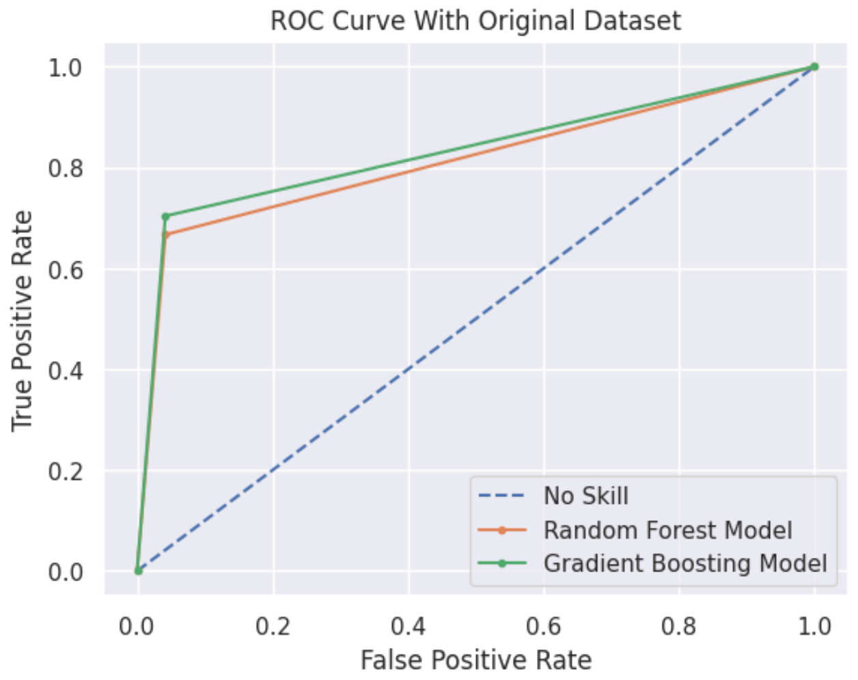
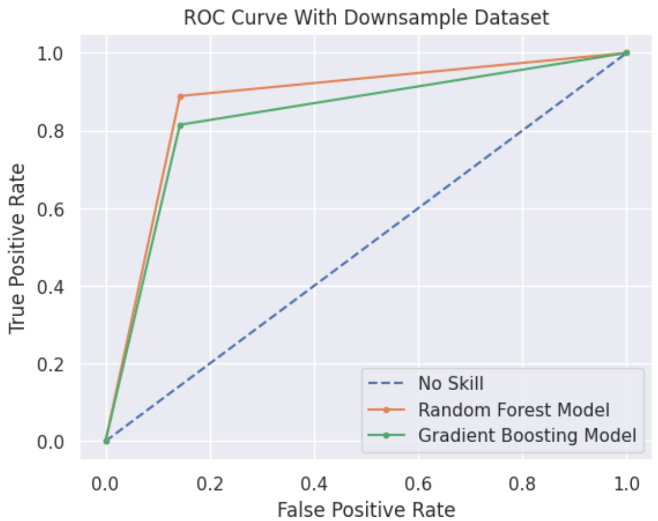
Result Analysis : ROC Graphs of the Top Models
The rationale behind ROC AUC lies in its assessment of a binary classifier's ability to differentiate between positive and negative classes. It quantifies the likelihood that the model will accurately prioritize a randomly selected positive instance over a randomly chosen negative one. From the following two graphs, the downsample dataset trained the model better.
Random Forest Models AUC = 0.812
Gradient Boosting Model ACU = 0.831
Random Forest Models AUC = 0.873
Gradient Boosting Model ACU = 0.836

Slide 13
Discussion and Conclusion
Learning and Takeaways:
Feature selected is very important: Compare to models that trained with all 12 features, when only 5 features included to train, the accuracy still at 85%, which is an acceptable accuracy rate. The information can embedded in only very few key features.
Balanced sample can improve model performance: Compare training result between original and downsample dataset, a model such as random forest can be improved from 0.85 to 0.88.
Future Ways to Improve:
From Machine Learning Technique Perspectives:
Some more hyperparameter tuning can further improve the model accuracy
From Domain Knowledge Perspectives:
There are some important patient data missing from the dataset, such as lack of primary kidney disease information and the type of follow-up was carried out, etc
This dataset collected from a very specific area, Punjab, Pakistan, with relative undiverse patients population. Thus, the applicability to different types of patients with heart failure condition can be an exploration direction in the future.

Slide 14
Thank You!
Additional Information regarding to this project:
Video Presentation
Public Github Repository

